Slide 1
COMP 3500 Introduction to Operating Systems Project 2 –How to use the DEBUG macro?
Dr. Xiao Qin
Auburn University http://www.eng.auburn.edu/~xqin
xqin@auburn.edu
Notes:
See also Project 2 How to use the DEBUG macro-manual.docx

Slide 2
Lecture on Demand

Slide 3
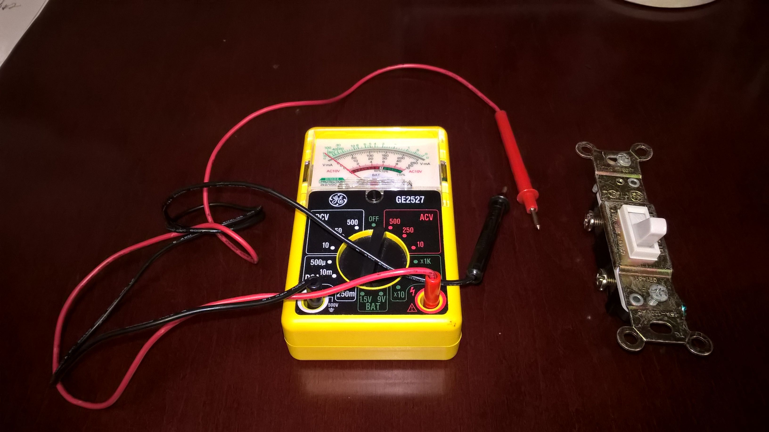
Notes:
Analogy between power switch and debug-message switch

Slide 4
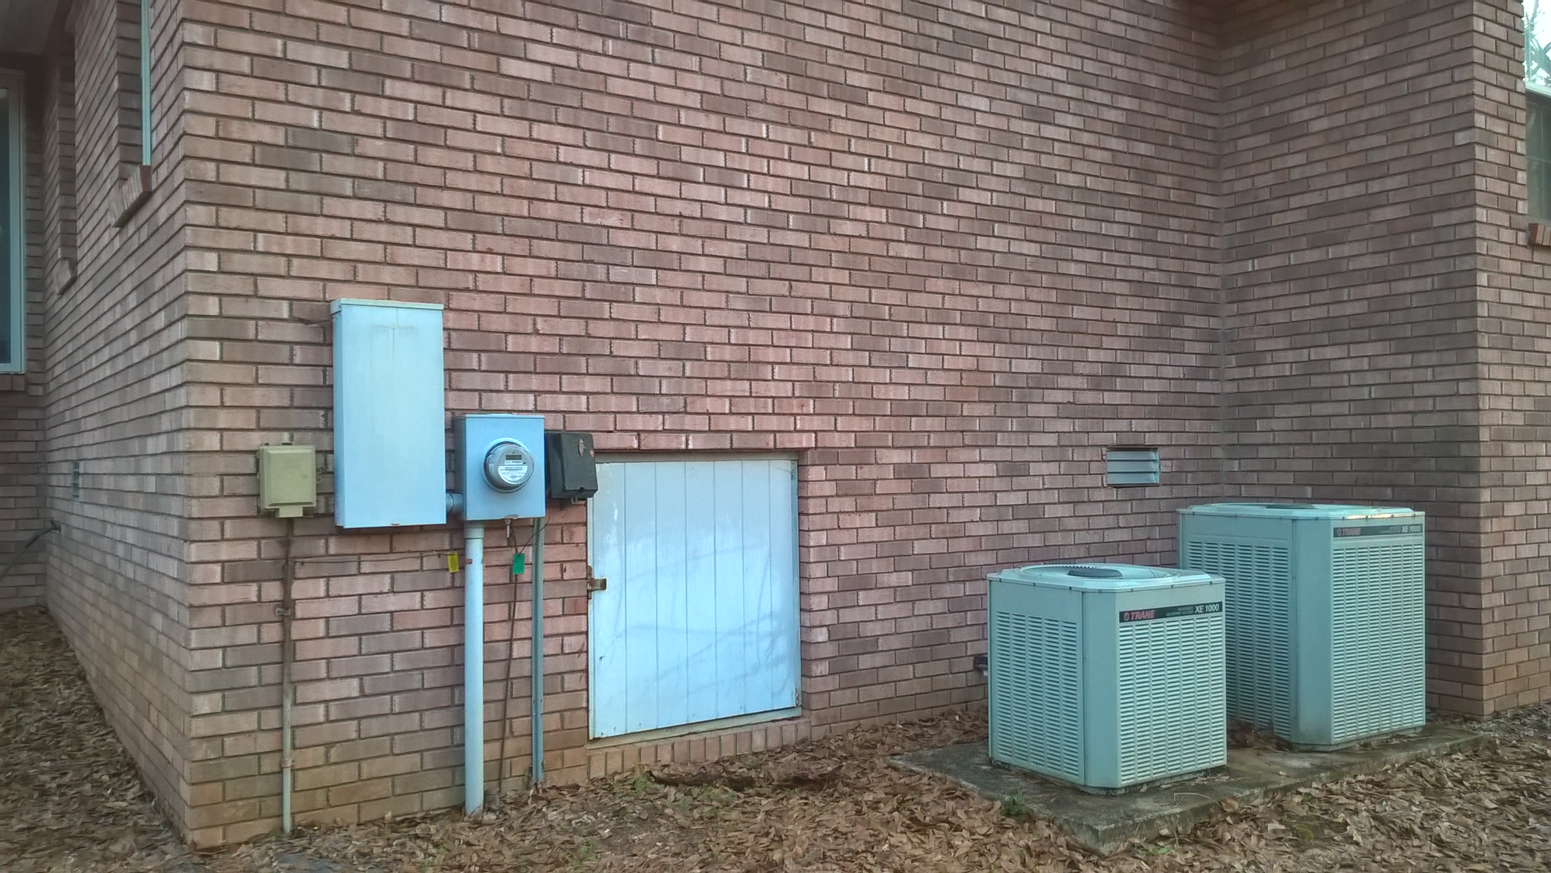
Notes:
Analogy between power switch and debug-message switch

Slide 5
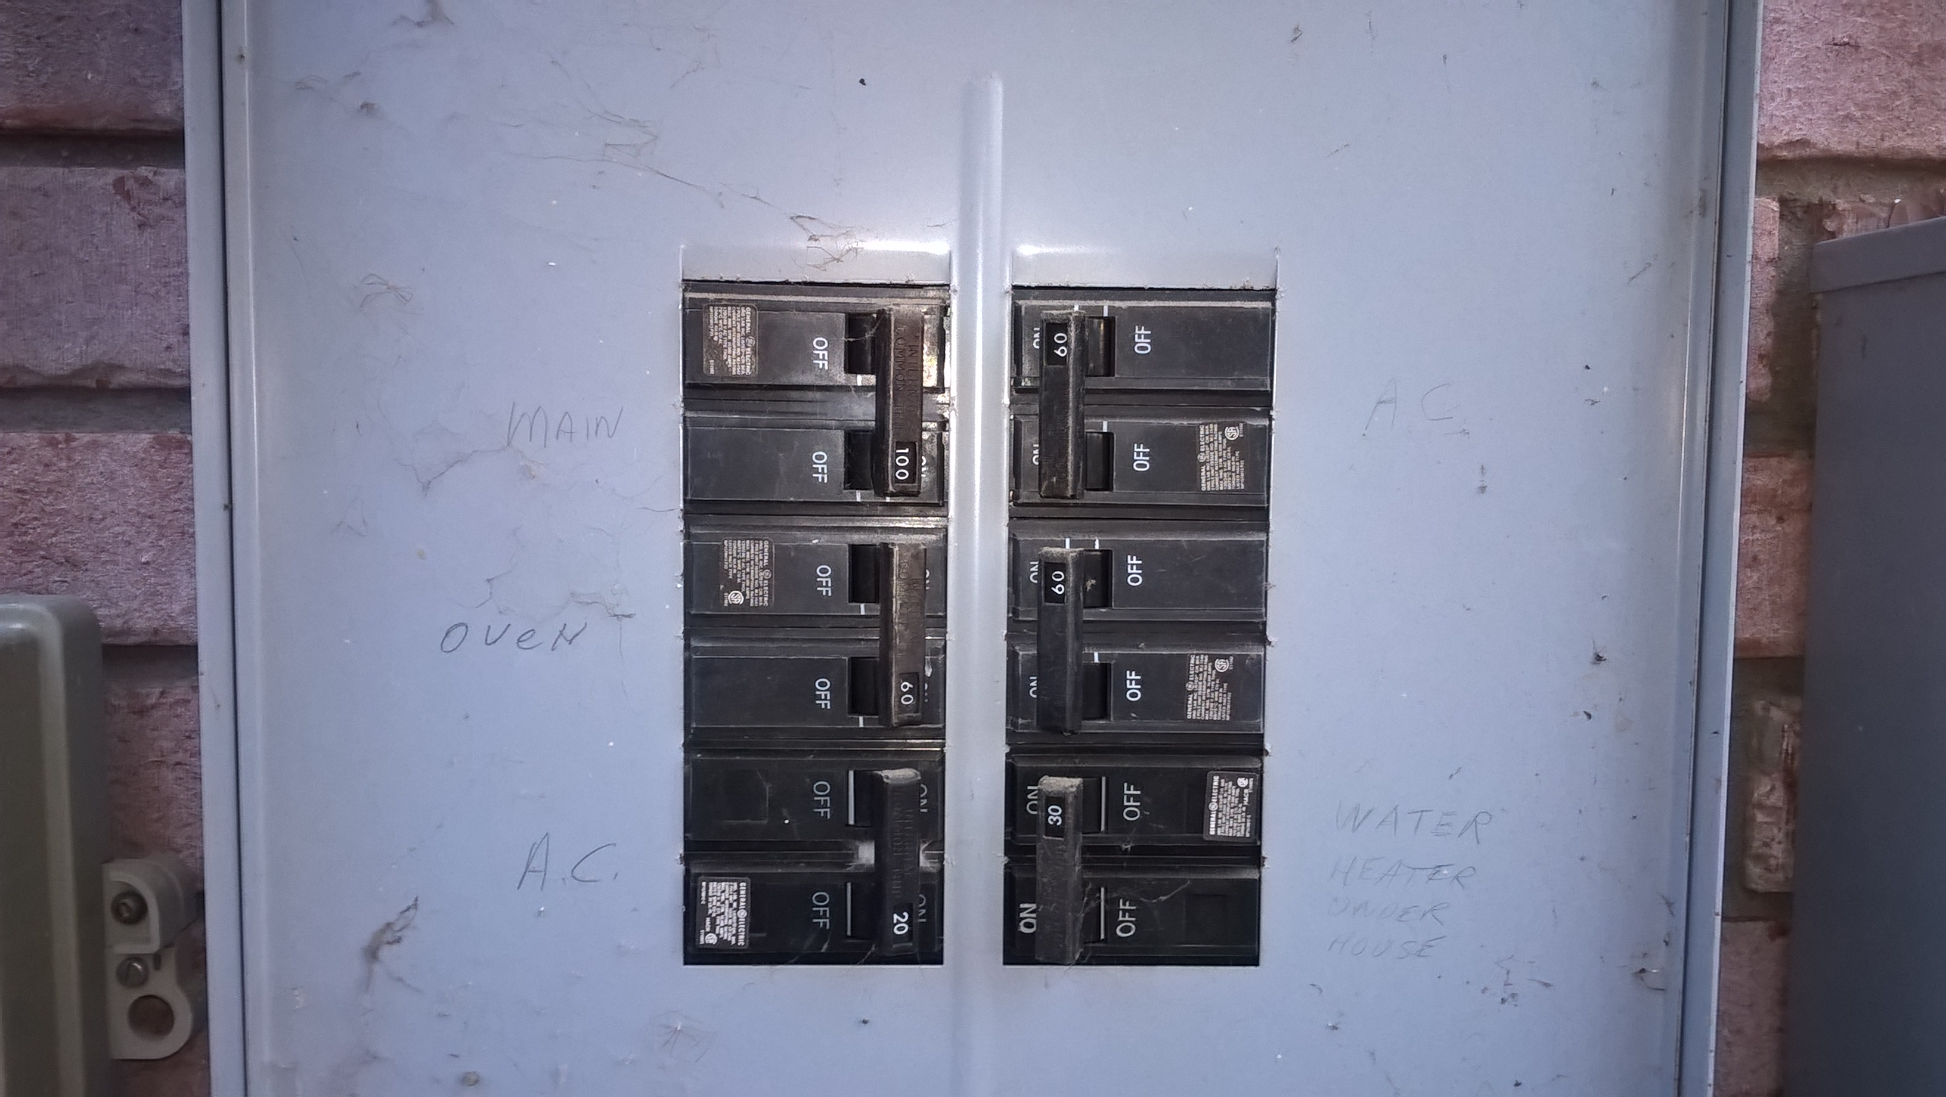
Notes:
Analogy between power switch and debug-message switch

Slide 6
The implementation of the DEBUG() macro
In kern/include/lib.h
Replace DEBUG(d, fmt, args…); with
dbflags & (d) ? Kprintf(fmt, ##args) :0;
if (dbflag & (d) != 0)
kprint(fmt, ##args);
/* else do nothing */

Slide 7
Sample Usage of the DEBUG() macro
DEBUG(d, fmt, args…); /* d is a flag */
The flag parameter ‘d’ is defined in kern/include/lib.h

Slide 8
Configure DEBUG messages
You can configure DEBUG messages using the dbflag variable defined in kern/lib/kprintf.c
/* How to configure? */
if (dbflag & (d) != 0)
kprintf(fmt, ##args);
/* else do nothing */
Notes:
See also 03a-Project 2 Demo-Manual.doc
6.
cs161/src
grep –r “stack” . |more

Slide 9
How to enable debug messages for multiple modules?
In kern/lib/kprintf.c
u_int32_t dbflags = DB_VM | DB_SYSCALL;
/* Don’t use || here.*/

Slide 10
How the debug-message configuration works?
Sample: We insert a debug message in the boot() function of main.c.
Go to line 76, add the following code.

Slide 11
Configure the dbflag variable in kern/lib/kprintf.c
u_int32_t dbflags = DB_VM | DB_SYSCALL;
Rebuild the ASST0 kernel now…

Slide 12
What do you expect?
Notes:
Answer: move the executable kernel into cs161/root

Slide 13
Modify the dbflag flag to Configure Debug Messages
kern/lib/kprintf.c
/*u_int32_t dbflags = DB_VM | DB_SYSCALL;*/
u_int32_t dbflags = DB_VM;
Rebuild the ASST0 kernel now…

Slide 14
What do you expect?
Notes:
Answer: move the executable kernel into cs161/root

Slide 15


Slide 16
Project 2: Error 127 Command Not Found
Error at step 6: %make depend, which builds the ASST0 kernel.
Search on Google; it says something about gcc not being installed, but that can't be the case.
Solution: Use ‘echo $PATH’ to check your $PATH. Your $PATH must contains ~/cs161/bin You can run the following command to setup your path.
export PATH=~/cs161/bin:$PATH
Notes:
Chapter 3 Summary

